Slide 1


Line
Notes:
This template is for educational, non-commercial purposes only. For more free game templates like this one, visit https://www.taysteachingtoolkit.com

Slide 2






Put your cards in a line in any order.
카드를 어떤 순서로든 줄을 서세요.
Notes:
NOTE:
To change the picture without disrupting the animation, click the group, then click again to select only the picture icon. Right click on the picture icon and press “Change picture…” Choose the picture you want to replace it with from your files and click “Insert.” The picture must be saved to your computer for this to work, no copying and pasting.

Slide 3


Listen to the teacher.
go to the farm
Notes:
When, the game starts the students ask the teacher a question and the teacher answers with one of the cards (You can also play where the teacher just says a vocabulary word/sentence).

Slide 4

If the word/sentence I say is at either end of your line, take away that card.
만약 내가 말한 단어가 당신 행의 어느 한 쪽 끝에 있다면, 그 카드를 가져가라.
Notes:
NOTE:
To change the picture without disrupting the animation, click the group, then click again to select only the picture icon. Right click on the picture icon and press “Change picture…” Choose the picture you want to replace it with from your files and click “Insert.” The picture must be saved to your computer for this to work, no copying and pasting.

Slide 5

You can't take away middle cards. Only cards at the ends.
중간 카드를 빼면 안 돼요. 끝에 카드만.
Notes:
NOTE:
To change the picture without disrupting the animation, click the group, then click again to select only the picture icon. Right click on the picture icon and press “Change picture…” Choose the picture you want to replace it with from your files and click “Insert.” The picture must be saved to your computer for this to work, no copying and pasting.

Slide 6
Notes:
NOTE:
To change the picture without disrupting the animation, click the group, then click again to select only the picture icon. Right click on the picture icon and press “Change picture…” Choose the picture you want to replace it with from your files and click “Insert.” The picture must be saved to your computer for this to work, no copying and pasting.

Slide 7
If you take away all your cards, say BINGO! You win the game!
카드를 다 가져가면 빙고라고 해! 네가 이겼어!
BINGO!
Notes:
NOTE:
To change the picture without disrupting the animation, click the group, then click again to select only the picture icon. Right click on the picture icon and press “Change picture…” Choose the picture you want to replace it with from your files and click “Insert.” The picture must be saved to your computer for this to work, no copying and pasting.

Slide 8
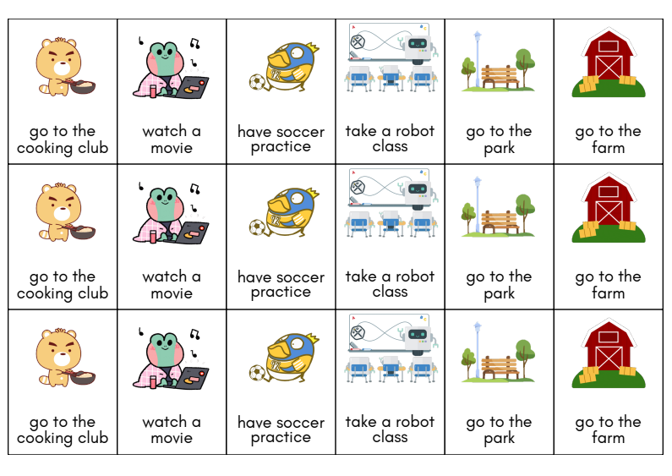

Slide 9
Line
Notes:
This template is for educational, non-commercial purposes only. For more free game templates like this one, visit https://www.taysteachingtoolkit.com

Slide 10
Put your cards in a line in any order.
word or sentence
word or sentence
word or sentence
word or sentence
word or sentence
word or sentence
Notes:
NOTE:
Replace the text in the boxes with your class’ vocabulary or target language.

Slide 11
Question goes here
Answer goes here
Notes:
When, the game starts the students ask the teacher a question and the teacher answers with one of the cards (You can also play where the teacher just says a vocabulary word/sentence).

Slide 12
If the word/sentence I say is at either end of your line, take away that card.
word or sentence
word or sentence
word or sentence
word or sentence
word or sentence
word or sentence
Notes:
NOTE:
Replace the text in the boxes with your class’ vocabulary or target language.

Slide 13
You can't take away middle cards. Only cards at the ends.
word or sentence
word or sentence
word or sentence
word or sentence
word or sentence
word or sentence
Notes:
NOTE:
Replace the text in the boxes with your class’ vocabulary or target language.

Slide 14
word or sentence
word or sentence
word or sentence
word or sentence
word or sentence
word or sentence
word or sentence
word or sentence
word or sentence
word or sentence
word or sentence
word or sentence
Notes:
NOTE:
Replace the text in the boxes with your class’ vocabulary or target language.

Slide 15
If you take away all your cards, say BINGO! You win the game!
BINGO!
word or sentence
word or sentence
word or sentence
word or sentence
word or sentence
word or sentence
Notes:
NOTE:
Replace the text in the boxes with your class’ vocabulary or target language.

Slide 16

Notes:
Replace the filler images with the images you need and print out 1 set per student

Slide 17
word or sentence
word or sentence
word or sentence
word or sentence
word or sentence
word or sentence
word or sentence
word or sentence
Notes:
Replace the text in the boxes with your class’ vocabulary or target language and print out 1 set per student

